Slide 1
Linux Graphics初窥
fbdev&DRM简介及“hello-world”coding​

Slide 2
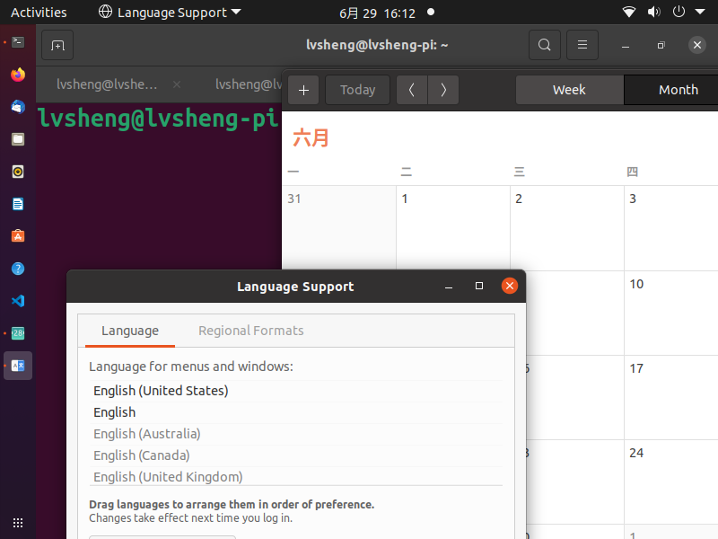
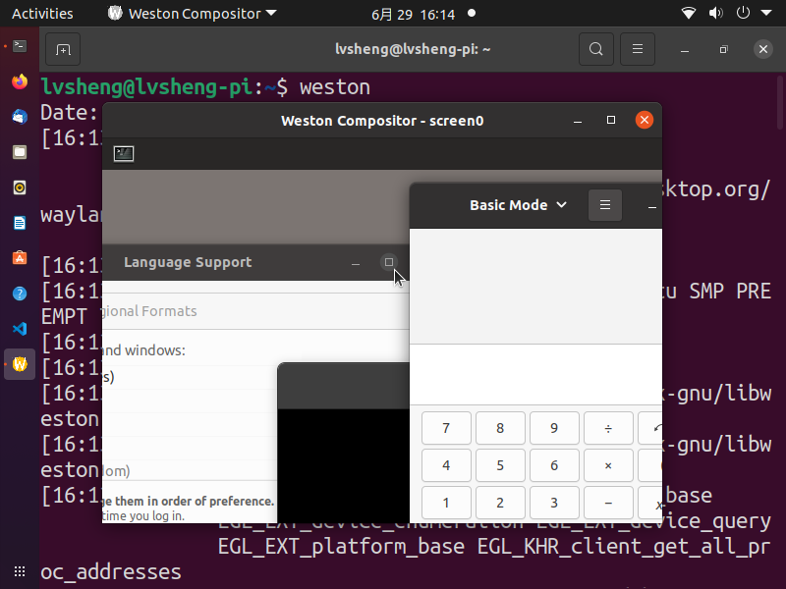
PC桌面: X11 / Wayland
多窗口
Weston后端

Slide 3
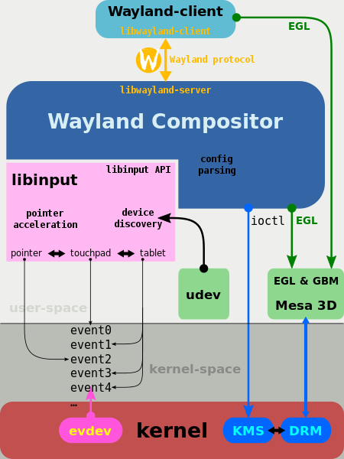
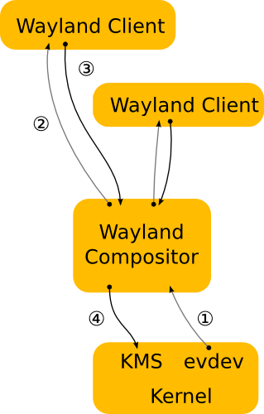
Wayland
https://wayland.freedesktop.org/architecture.html
https://en.wikipedia.org/wiki/File:Libinput_for_Wayland_compositors.svg
KMS(Kernel mode setting)、DRM(Direct Rendering Manager)、Mesa、EGL(see Android)、ioctl

Slide 4
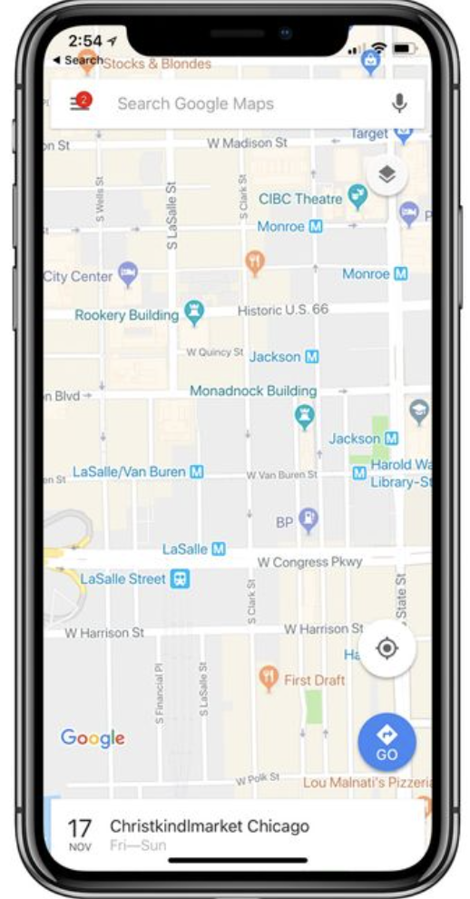


如何直出屏幕？

Slide 5
如何直出屏幕？ 1. fbdev

Slide 6
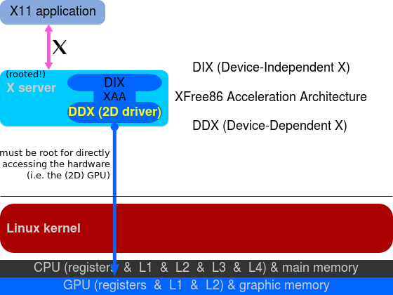
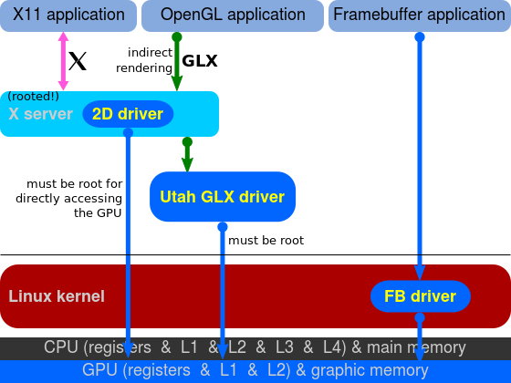
fbdev
演化
https://en.wikipedia.org/wiki/Direct_Rendering_Infrastructure#History

Slide 7
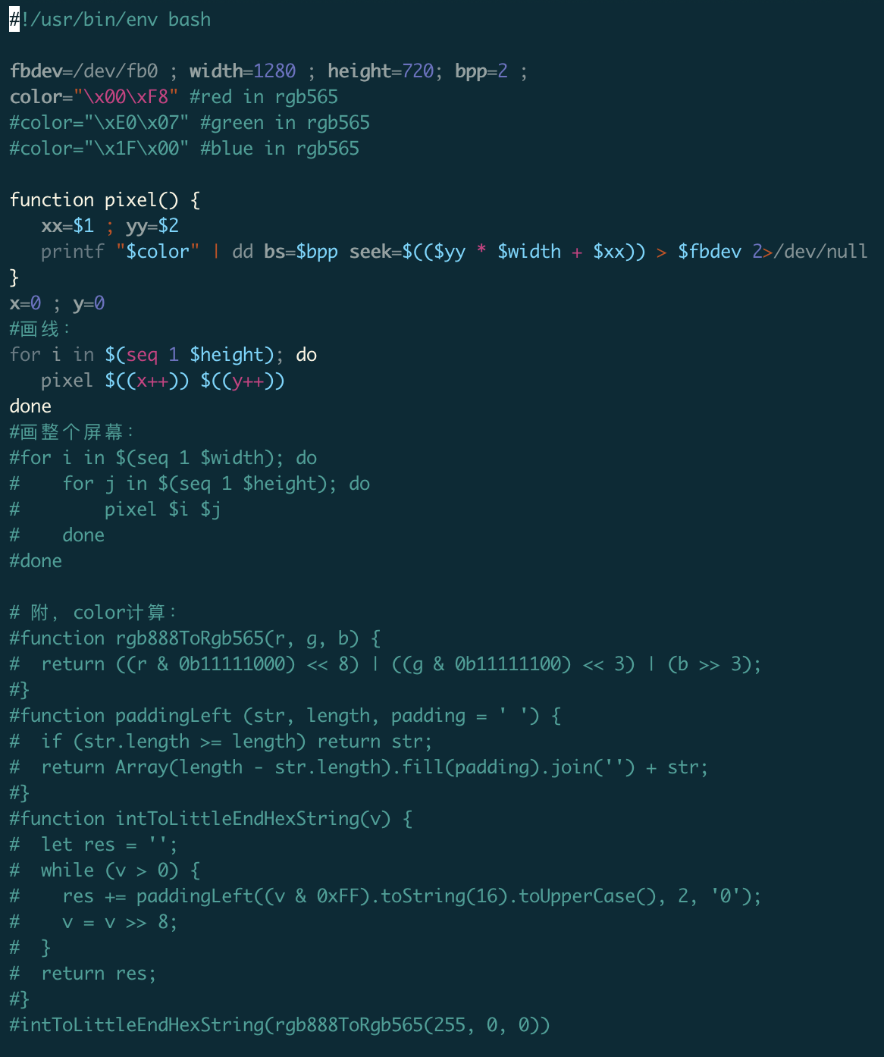
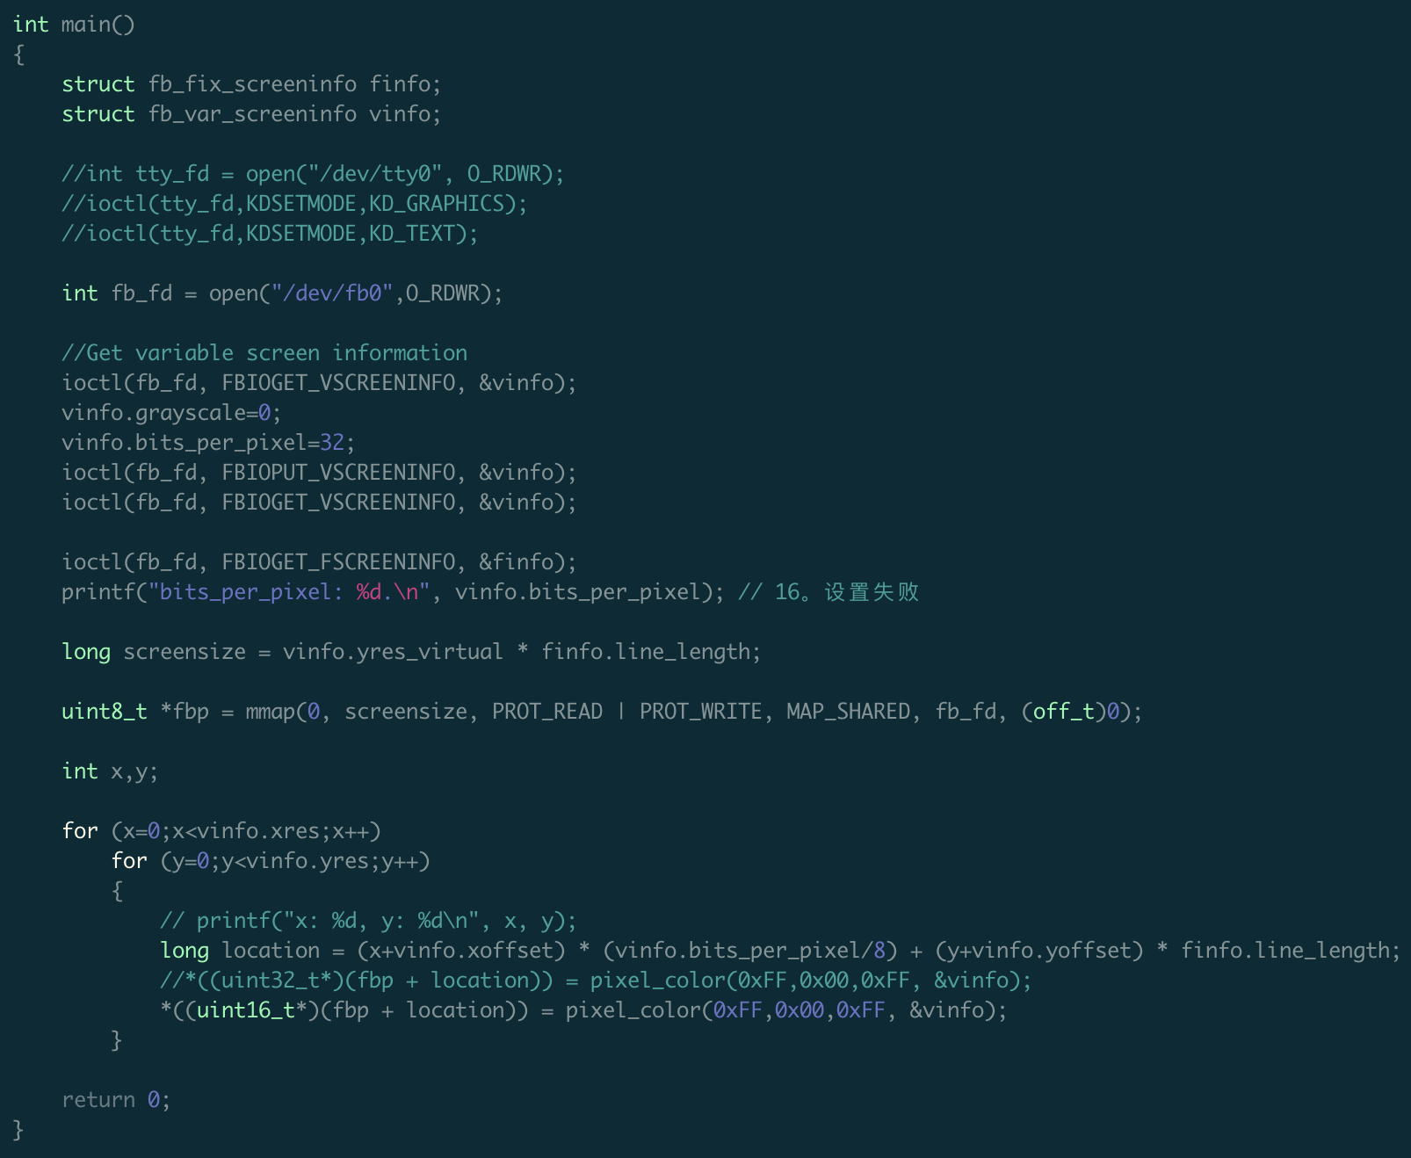
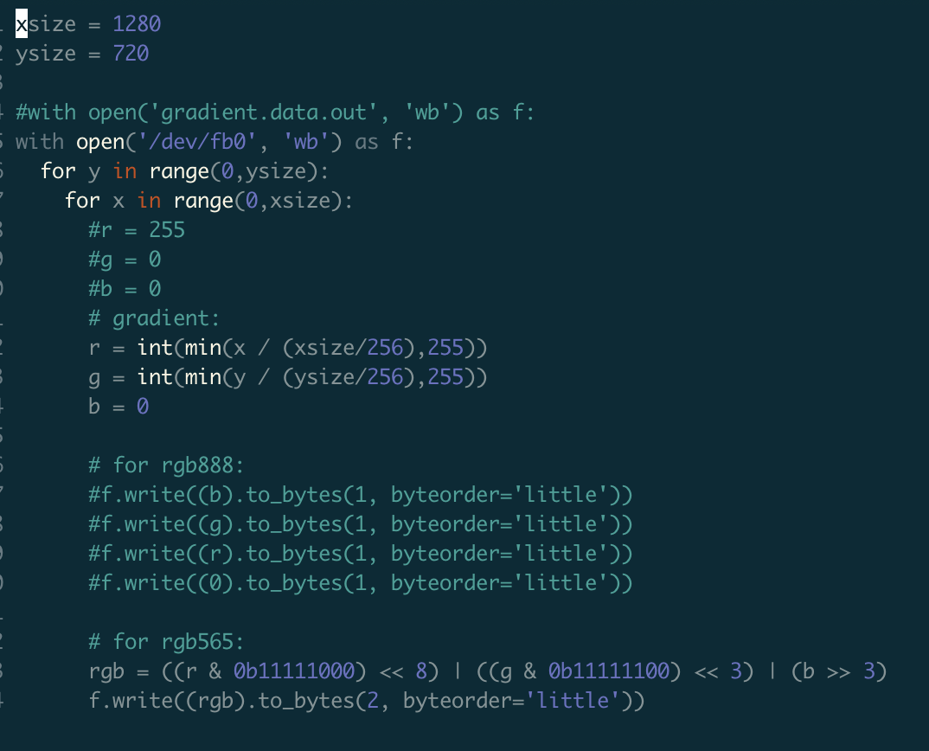
fbdev – code
/dev/fb0
source code

Slide 8
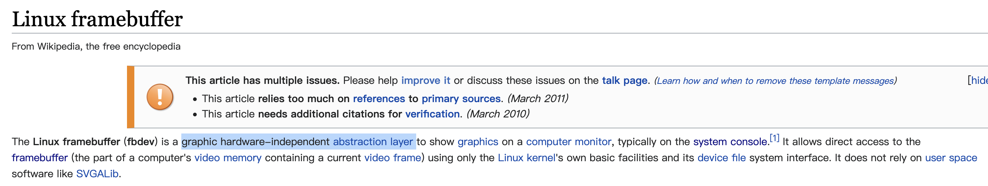
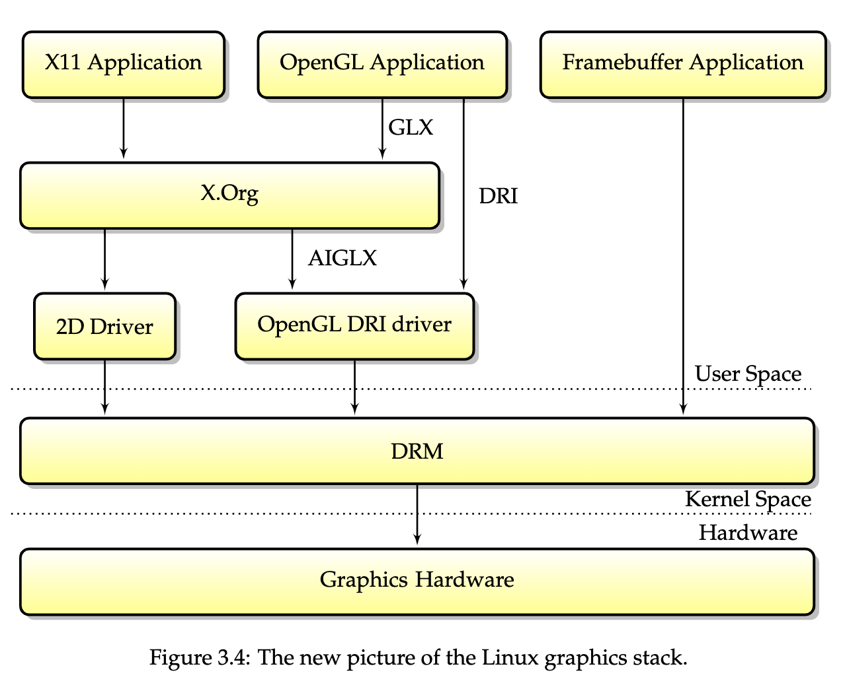
ps: is abstraction layer
https://en.wikipedia.org/wiki/Linux_framebuffer
https://people.freedesktop.org/~marcheu/linuxgraphicsdrivers.pdf

Slide 9
如何直出屏幕？ 2. DRM

Slide 10
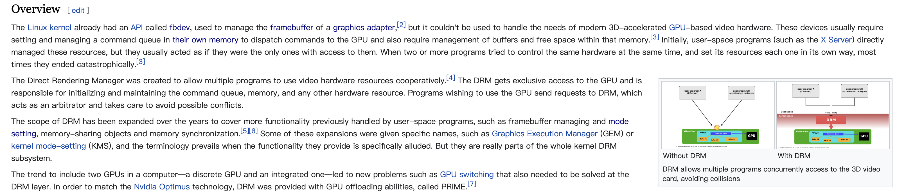
DRM – 源起
硬件加速 -> 多程序冲突 -> DRM统一管理
https://en.wikipedia.org/wiki/Direct_Rendering_Manager

Slide 11
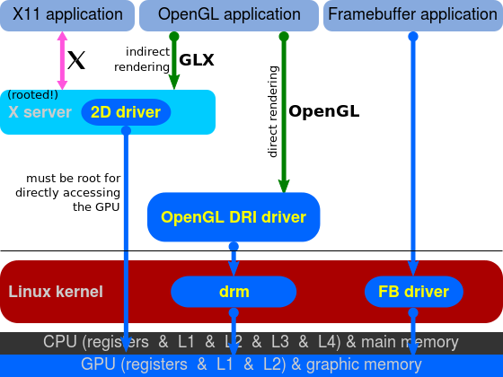
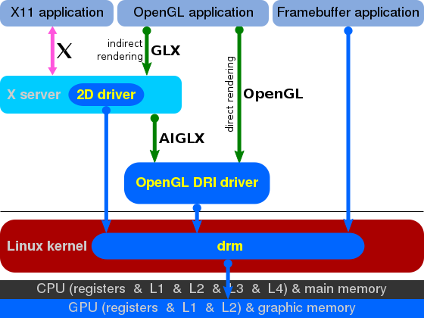
DRM – 演化

Slide 12
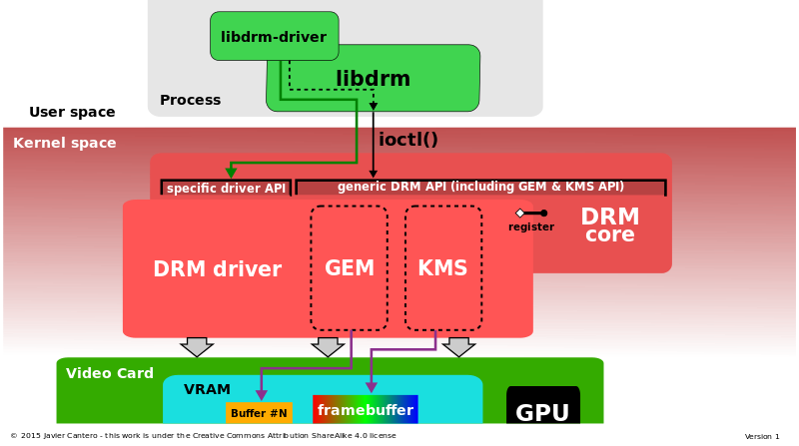
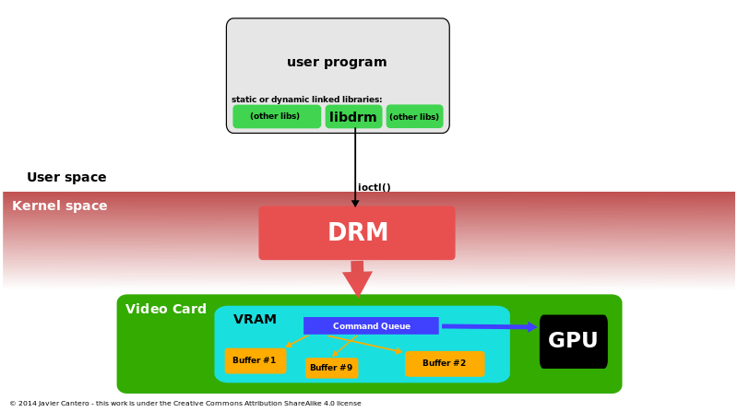
DRM – 结构
https://en.wikipedia.org/wiki/File:High_level_Overview_of_DRM.svg
https://en.wikipedia.org/wiki/File:DRM_architecture.svg

Slide 13
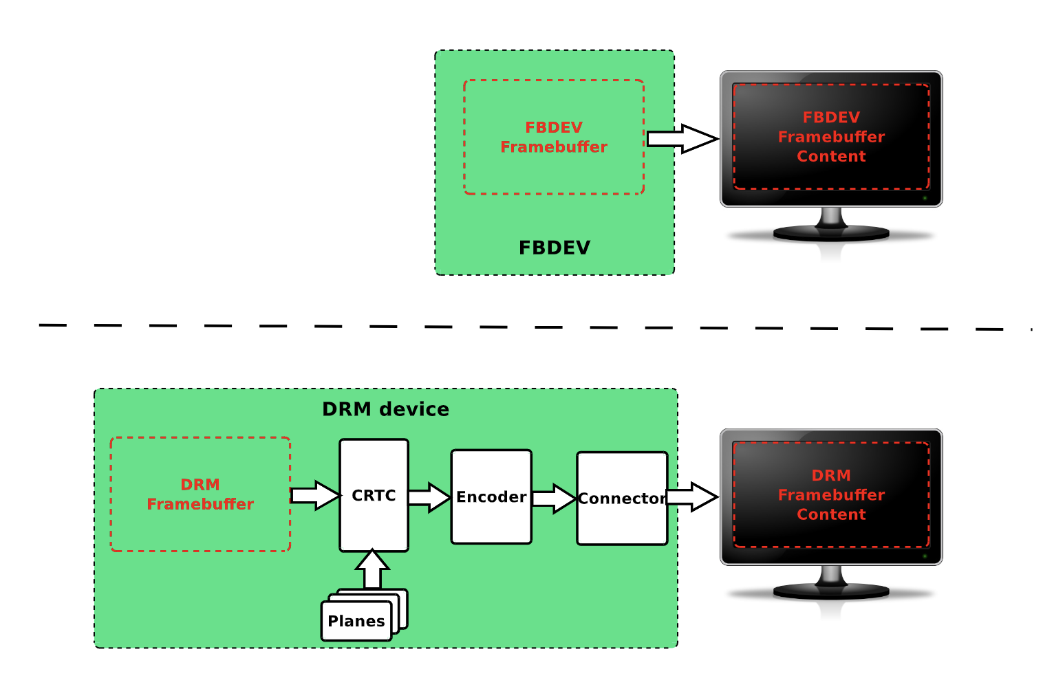
fbdev vs DRM
https://events.static.linuxfound.org/sites/events/files/slides/brezillon-drm-kms.pdf

Slide 14
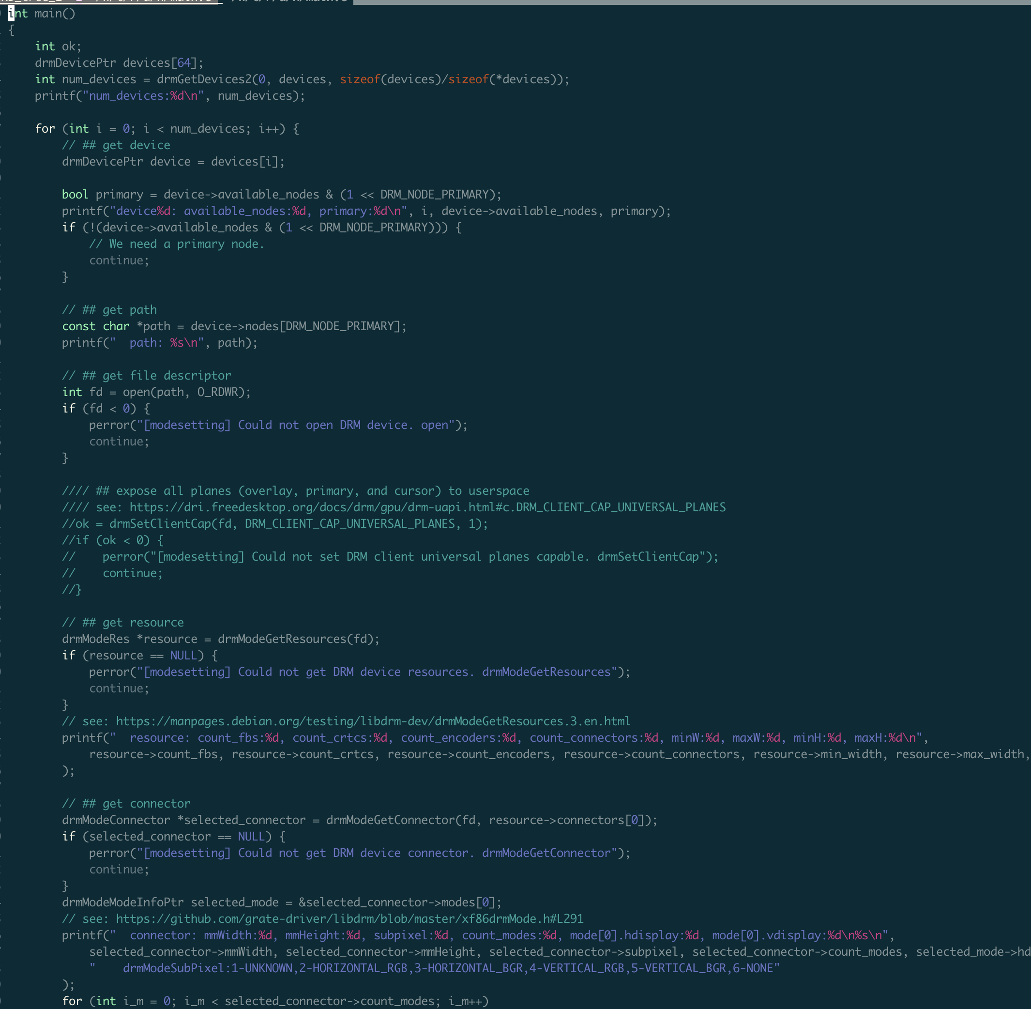
DRM - code
source code

Slide 15
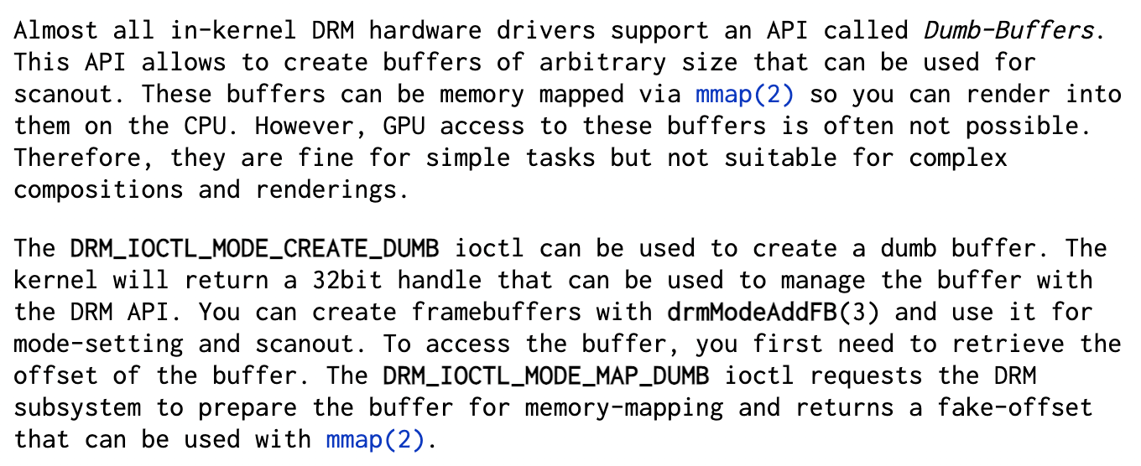
Dumb-Buffers
https://manpages.debian.org/jessie/libdrm-dev/drm-memory.7.en.html#Dumb-Buffers
Notes:
一边看代码，一边对应这里的各个操作

Slide 16
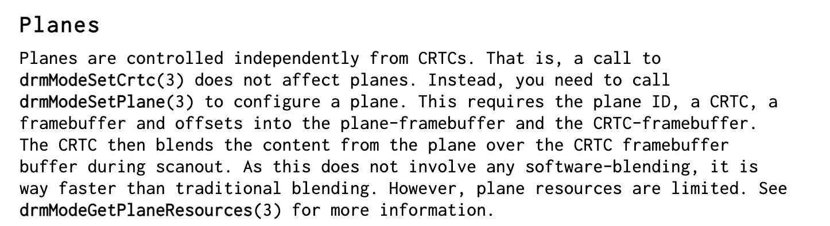
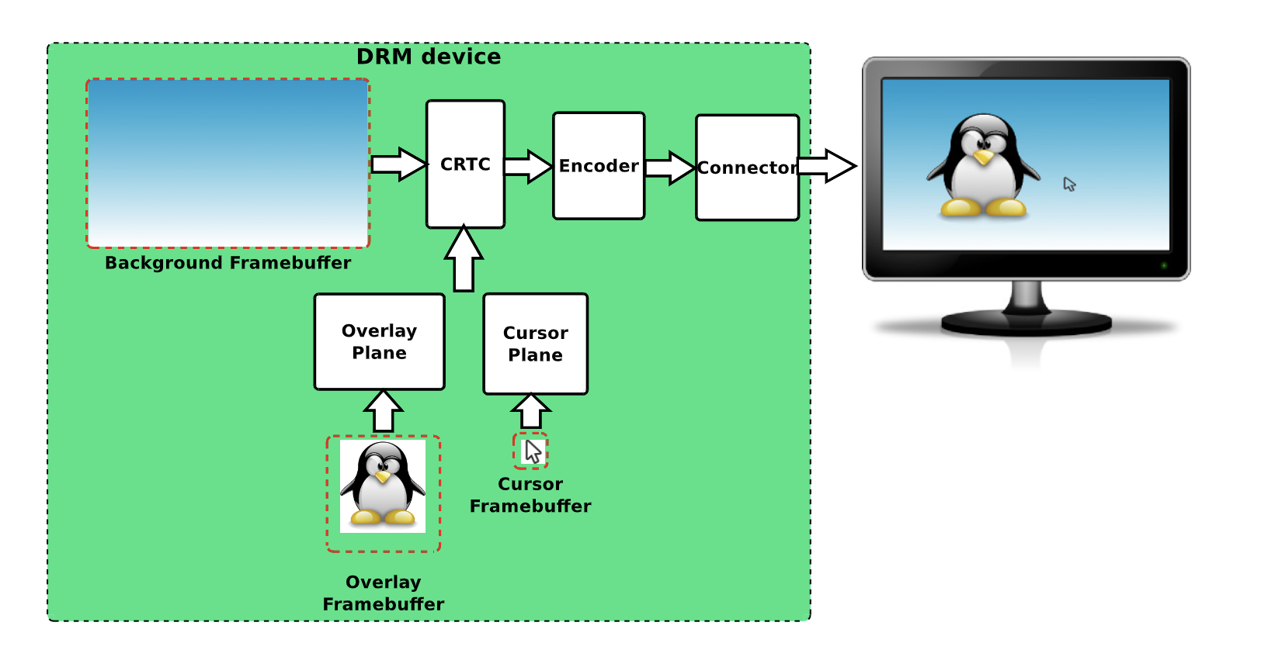
Planes
Android: Android Hardware Composer
https://manpages.debian.org/unstable/libdrm-dev/drm-kms.7.en.html#Planes

Slide 17
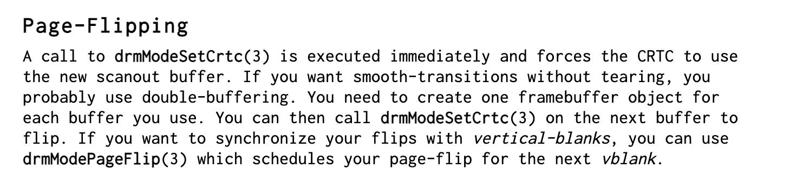
vsync
drmModeSetCrtc() -> drmModePageFlip()
flutter-embedded-linux vs flutter-pi
lock
drm-howto/modeset-vsync.c
drmEventContext.page_flip_handler、drmHandleEvent、 drmModePageFlip
https://manpages.debian.org/unstable/libdrm-dev/drm-kms.7.en.html#Page-Flipping
Notes:
后面flutter-pi会进一步看

Slide 18
CPU直写Dumb-Buffer， GPU呢？

Slide 19
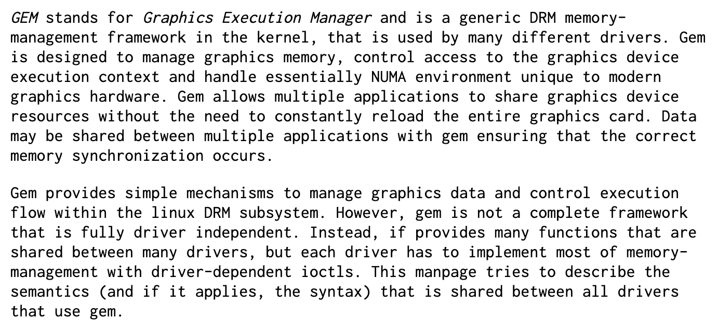
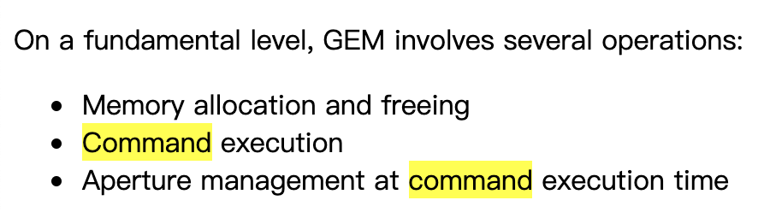
GEM（ Graphics Execution Manager ）
https://manpages.debian.org/jessie/libdrm-dev/drm-memory.7.en.html#GEM
https://01.org/linuxgraphics/gfx-docs/drm/drm-memory-management.html#drm-gem
Notes:
没有细研究。稍后看flutter-pi代码可以看到一点

Slide 20
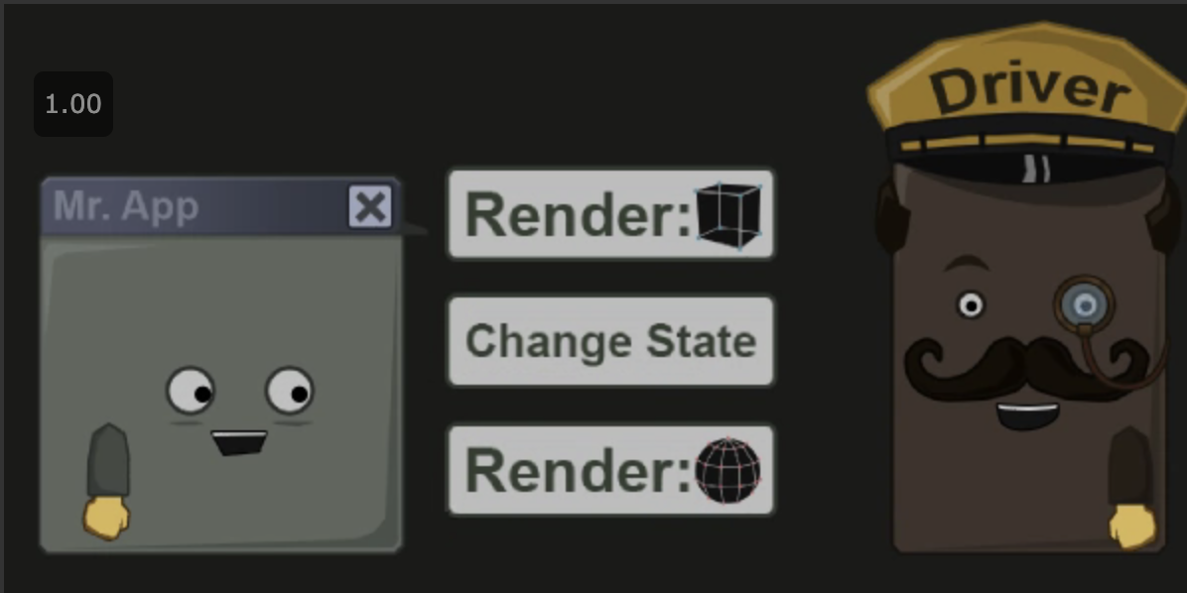
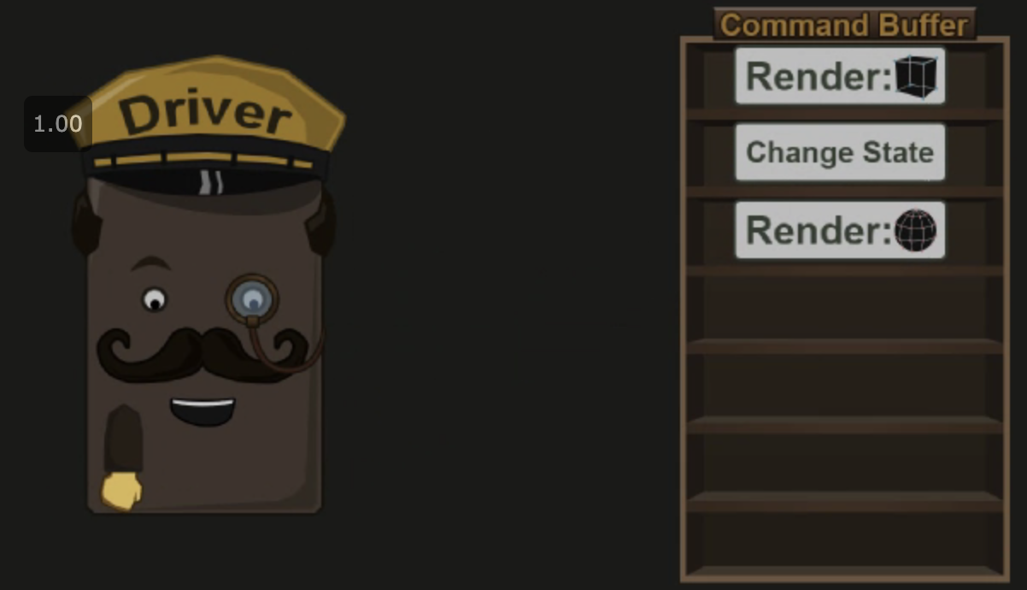

Command Buffer
https://simonschreibt.de/gat/renderhell-book2/

Slide 21
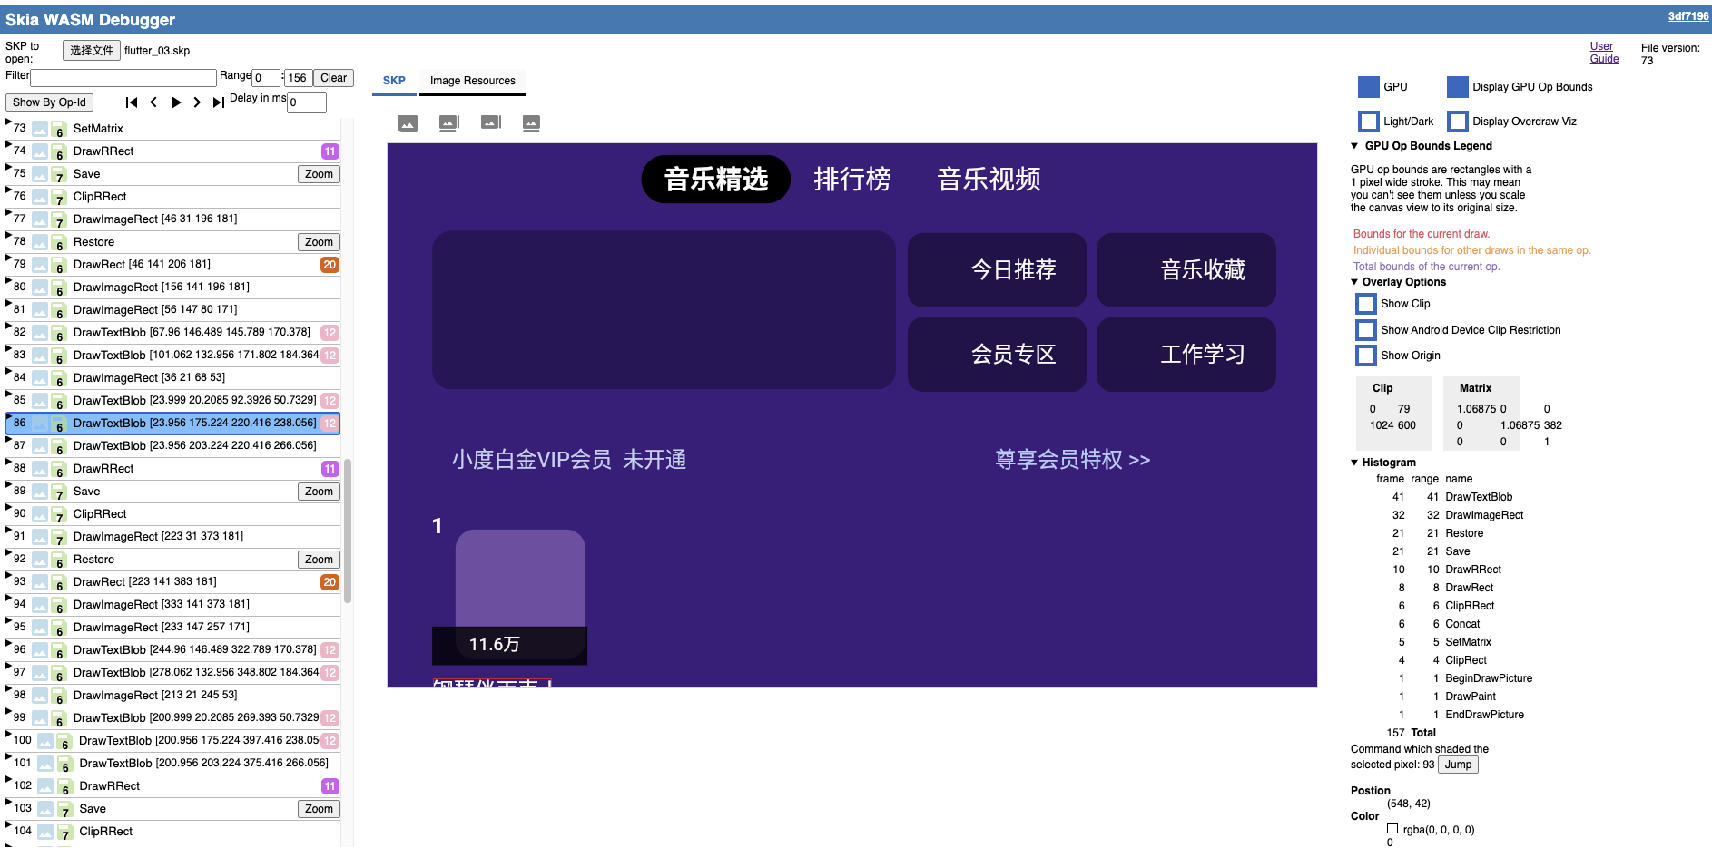
例：Skia draw commands
http://agroup.baidu.com/atom_native/md/article/3540249

Slide 22
flutter-pi代码
初始化：
FlutterCompositor.create_backing_store_callback
-> on_create_backing_store
-> rendertarget_nogbm_new（仅看非gbm分支）
-> glGenFramebuffers
-> create_drm_rbo（两次，双buffer）
-> drmModeAddFB2 -> drm_fb_id （以egl调用为back）
-> target->present = rendertarget_nogbm_present
Flutter内容更新：
FlutterCompositor.present_layers_callback
-> on_present_layers
-> eglSwapBuffers
-> target->present_legacy
-> rendertarget_gbm_present_legacy
-> drmdev_legacy_overlay_plane_pageflip
-> drmModeSetPlane
vsyn信号到来：
drmHandleEvent drmEventContextPtr.page_flip_handler
-> on_pageflip_event
-> FlutterEngineOnVsync
（注：仅考虑了最简易分支）
Notes:
对应前面GEM与vsync中接口

Slide 23
参考：
The DRM/KMS subsystem from a newbie’s point of view
DRM（Direct Rendering Manager）学习简介
drm-memory
Render Hell —— 史上最通俗易懂的GPU入门教程
原文: Render Hell 2.0
The Wayland Protocol High-level design
Introduction to the Direct Rendering Infrastructure、dri.freedesktop.org
VRAM
GPU Architecture

